Slide 1
Enterprise Research Data
Security Plan (ERDSP)
TRAINING
Dial in: 1 (415) 655-0052
Access Code: 587-526-195
Slides in “Handout” Tab
Terry A. Peters
March 20, 2020
This Briefing is: UNCLASSIFIED//FOR OFFICIAL USE ONLY

Slide 2
Training Overview
This training session covers the new Enterprise Research Data Security Plan (ERDSP).
  Provide VHA Research stakeholders an overview of the Enterprise Research Data Security Plan (ERDSP) that will be implemented within the VA Innovation and Research Review System (VAIRRS)
  Communicate key benefits of the ERDSP
  Identify training resources available to VHA Research stakeholders
  Communicate Research Support Division (RSD) efforts to support the Office of Research and Development (ORD) with the VAIRRS implementation

Slide 3
Enterprise Research Data Security Plan Development (1 of 2)
The ERDSP is a collaborative effort between VHA Data Owners (ORD, ORO, OIS, ESO) to balance security needs and security control requirements against the following factors:
  The Mission of VHA Research
  Operational Use of the Data within the Environment
  Identified Risks
  Available Resources

Slide 4
Enterprise Research Data Security Plan Development (2 of 2)
The ERDSP was developed in response to the Enterprise Cybersecurity Risk Assessment for Research Protocol Data Management.
The ERDSP is a central element of the selection of administrative, technical, and operational safeguards and implementation of research protocol data risk management.

Slide 5
Enterprise Research Data Security Plan (ERDSP) Overview (1 of 3)
The ERDSP provides a mechanism to account for the security of research protocol data during each stage of the data management life cycle and is a reliable way to ensure the consistent evaluation of a research protocol’s data usage, storage, sharing, and transmission requirements by:
  Implementing a standardized template and plan designed to provide research principal investigators (PIs) with a tool to aide in documenting the safeguards used to protect research data, information, and resources.
  Providing a mechanism for PI’s to document their plan for managing risks to protect research data within a research protocol, and promoting the standardization of the ISSO review during the IRB/R&DC review process per policy.

Slide 6
Enterprise Research Data Security Plan (ERDSP) Overview (2 of 3)
The ERDSP enables the following objectives:
  Assisting PI’s with documenting how research data (human subject, basic science, animal) will be protected.
  Assisting ISSOs with employing consistent security review checks.
  Simplifying the process of completing and submitting an Enterprise Research Data Security Plan (ERDSP).
  Increasing the consistency of the information submitted in the form.
  Clarifying whether or not ISSO approval is required for an ERDSP.

Slide 7
Enterprise Research Data Security Plan (ERDSP) Overview (3 of 3)
The ERDSP is required for Human, Basic Science and Animal studies.
The ERDSP form utilizes branching logic.
  Branching logic surveys are basically intelligent surveys that place relevant questions in front of the users. Based on these questions, not only are the users able to see a page they are interested in, but the survey also takes into account the answers, and constructs the next question accordingly.
  Each of the questions takes respondents to a designated question. From there they are further taken to the page of their liking. If the next question does not align with the user’s current answer, that question is skipped and the user is taken to a more relevant question. A branching logic survey allows the users to follow a certain flow based on their answers.
  In short, the path of the user takes can be reconstructed with every answer. The path can keep branching out until all questions have been addressed. The path through the form can vary for each user or respondent.

Slide 8
Key Personnel Responsibilities
Complete the ERDSP for each research study and amendment
Work with the ISSO to resolve research study information security issues in a timely manner
Principle Investigators
Review research studies that require an ISSO review
Assist the PI in resolving research study information security issues in a timely manner
Facility ISSOs
Research Support Division
Provide ERDSP guidance as needed
Maintain ERDSP template and User Guide documentation

Slide 9
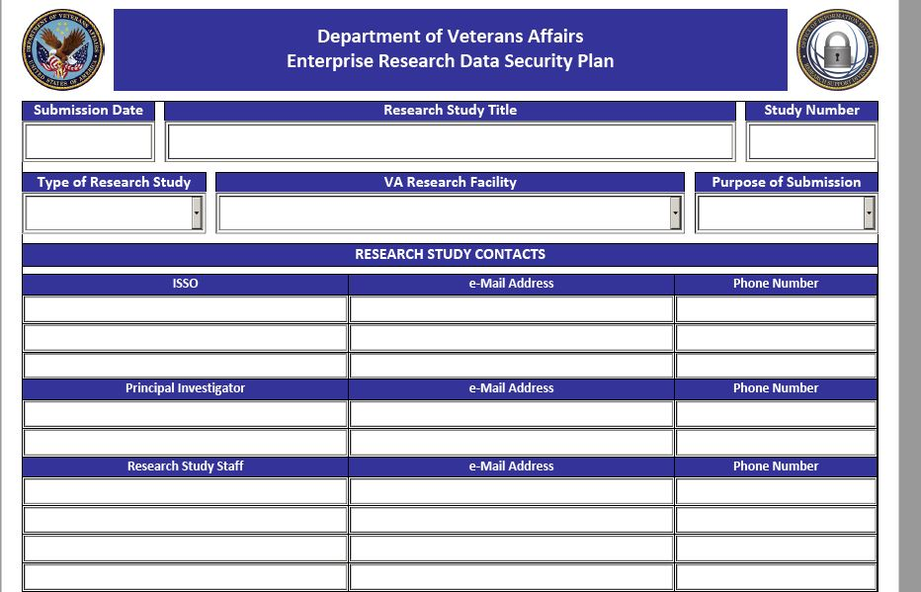
Completing the ERDSP
When initiating a new ERDSP, begin by completing the basic information about the research study at the top of the form.

Slide 10
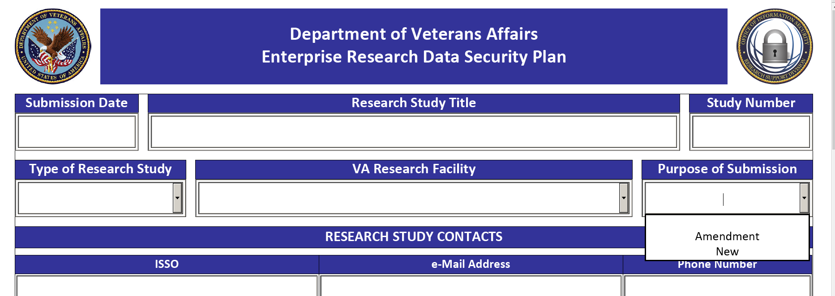
Completing the ERDSP
Your response in the “Purpose of Submission” block activates the branching logic within the form and will determine the next question to be displayed.

Slide 11
ERDSP Sections
The ERDSP Form is divided into twelve numbered sections. Each of these sections contains questions that must be answered if they are displayed.
  Research Study Conditions
  Data Categorization
  Data Source and Collection
  Data Access and Storage
  Data Sharing and Transmission
  Mobile Devices
  Applications
  Web Application Security
  Agreements and Contracts
  External Information Systems
  Incident Reporting & Security Awareness Training
  Amendment to Research Study
Use the ERDSP User Guide to assist in completing the ERDSP. The ERDSP User Guide is available within VAIRRS and on the RSD SharePoint: https://vaww.portal2.va.gov/sites/infosecurity/fieldsecurity/rs/default.aspx

Slide 12
Section 1 – Research Study Conditions
The research study conditions development was a collaborative effort between RSD, ORD, and ORO.
The purpose of the study conditions was to alleviate the need to conduct unnecessary ISSO security reviews and align security resources based on high risk areas and specific conditions. Examples include:
  Storage and Processing of VA Sensitive Information on Non-VA External Information Systems/Networks;
  Storage of VA Sensitive Information on VA and Non-VA IT Devices without adequate baselines;
  Unaccountable usage of VA and Non-VA IT Equipment used for Research;
  Unapproved usage of Mobile and Portable Devices/Applications;
  Incorrect Configuration of Mobile and Portable Devices/Applications; and
  Unauthorized Access to Research data.

Slide 13
Section 1 – Research Study Conditions
Will any research study data be stored, processed, shared and/or transmitted outside the VA protect environment?
Will the study utilize any External Information Systems or Devices?
Will the research study utilize any Mobile, Portable Storage, and/or Internet of Things (IoT) Devices?
Will the research study utilize any mobile applications or purchase/acquire any new software?

Slide 14
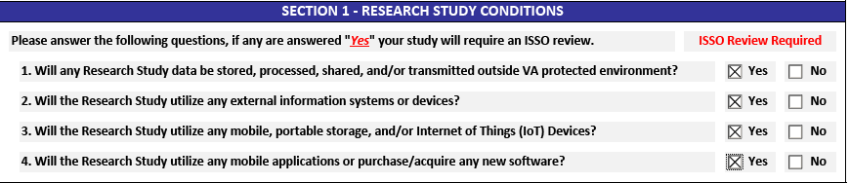
Section 1 – Research Study Conditions
If any of the study conditions are marked “Yes”, an ISSO review is required.

Slide 15
Section 2 – Data Categorization
VA Research data has been categorized into three categories: Sensitive, Non-Sensitive, and Public. The categorization of the data will determine the National Institute of Standards and Technology (NIST) security controls that will be applied to the study and the level of protection applied to the data collected in the study.
Sensitive – Data Types: III, PII, PHI, Animal Research (Category D & E Picture and Video), Limited Data Set, Genomic, BSL-3, Intellectual Property, and Select Agents & Toxins (FISMA Requirement = Moderate" FISMA Baseline Impact).
Non-Sensitive – Data Types: Deidentified Research, Animal Research (Category B&C) and Unpublished Research (Basic Animal except for category D&E with picture and video) & (Non-Human Basic Lab except for select agents & toxins) (FISMA Requirement = Moderate FISMA Baseline Impact).
Public – Data Types: Published Research (Aggregate data that can be submitted to peer review journals, presented at conferences, and/or included in grant applications).

Slide 16
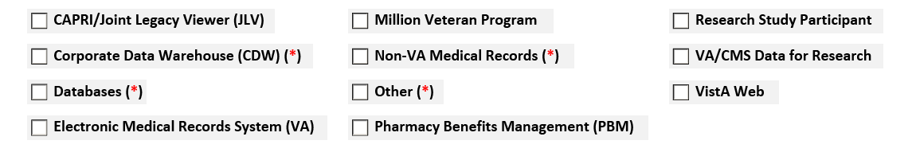
Section 3 – Data Sources & Collection (1 of 2)
Is this a multi-site research study (AC-21)?
Please provide the name of each entity participating in the study.
Select the data sources to be used in this research Study (AC-2)
If the data source has an asterisk (*) next to it, provide detailed information on the data source.

Slide 17
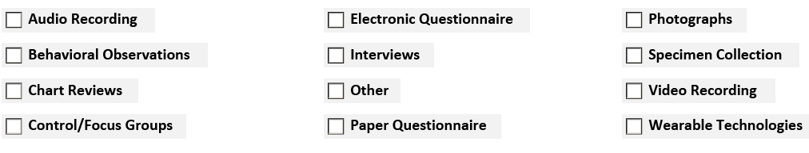
Section 3 – Data Sources & Collection (2 of 2)
4. What data collection methods will be used in the Research Study? Select all that apply.
5. Please specify and explain “Other” data collection methods.

Slide 18
Section 3 – Data Sources & Collection
ISSO Review Requirements
  The ISSO should validate that the data sources and data collection methods used in the research study are described in the protocol submission. The ISSO should document their review in the ISSO comments section.

Slide 19
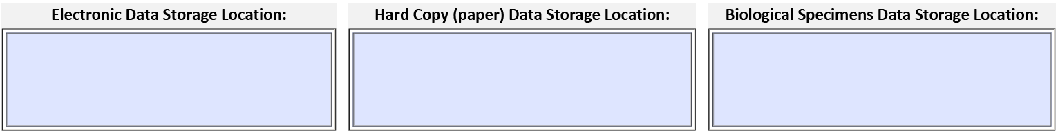
Section 4 – Data Access and Storage (1 of 2)
Will research study electronic file folders employ the principle of least privilege by allowing access only to users authorized to accomplish assigned research study tasks?
Who will manage access to your research study electronic files and folders?
Describe how hard copy (paper) documents will be physically secured.
Identify the storage location of the research study electronic, paper, and specimen data stored within the VA and outside the VA.

Slide 20
Section 4 – Data Access and Storage (2 of 2)
Will any research study data be stored on a standalone computer, medical device, and/or research scientific computing device?
Describe the process to back up the research study data stored on the standalone system, medical device, and/or research scientific computing.

Slide 21
Section 5 – Data Sharing & Transmission
Will the research study be sharing any data with a non-VA entity(s)?
Provide the name of the non-VA entity(s) and describe the method used to securely transfer the research study data to the non-VA entity(s). Include web/eCRF address, if applicable.
Will VA retain ownership of the data shared with the non-VA entity(s)?
Will the research study share study data with another VA facility(s)?
Provide the name of each VA entity with which the study data will be shared and describe the method used to securely transfer the data.
Will research study personnel physically transport research study data outside the VA protected environment?

Slide 22
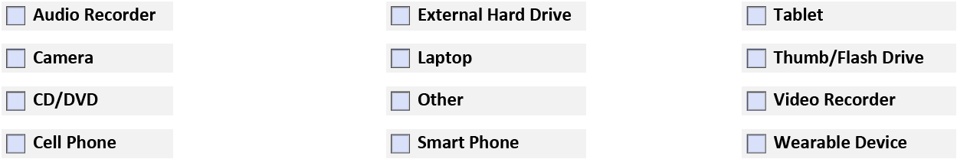
Section 6 – Mobile Devices
Select the type of mobile devices to be utilized during the research study. Select all that apply below:
Provide the make, model, EE/MX number, and device owner (VA, Sponsor, Affiliate, Subject participant) for each device.
Has the Area Manager, System Owner, or designee authorized the use of each VA owned (GFE) mobile device used in the research study?

Slide 23
Section 7 – Applications
Will any software be purchased or acquired for use within this research study?
Provide the name of software, vendor, vendor website address, and the purpose of the software.
Is the software approved for use in VA by TRM?
Will the study utilize any mobile applications?
Provide the name of the mobile application, vendor, website link, and purpose.
Has the mobile application been reviewed and approved for use in VA?

Slide 24
Section 8 – Web Application Security
Will the study utilize surveys?
What is the format of the surveys?
If the surveys are electronic, provide the name of the information system used to administrator the surveys and provide the web address to the electronic survey system.
Will the study utilize a website to register study subjects, register biological specimens, and/or retrieve lab results?
Provide the web address of the website and the owner of the website.

Slide 25
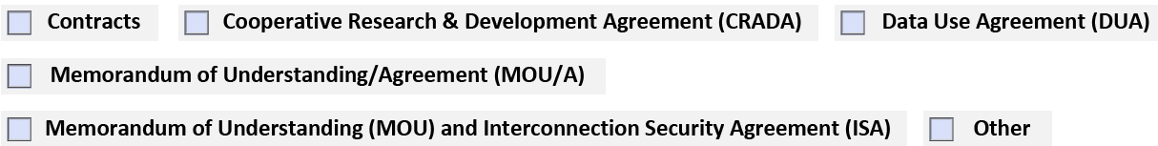
Section 9 – Agreements and Contracts
Will the research study utilize any agreements/contracts?
Select all that apply.
Describe the purpose of each agreement/contract and provide the names of each party involved in the agreement/contract selected.

Slide 26
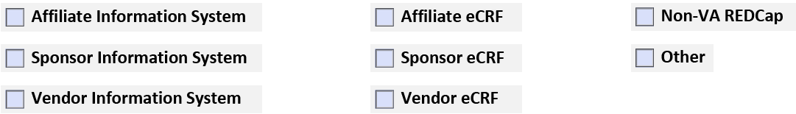
Section 10 – External Information Systems (1 of 2)
Will the research study data collected, processed, and/or stored on the external information system(s) be considered VA owned data?
Select the type of external information system that will be used in this research study.
Provide the name of the external information system, web address, and describe what the system will be used for in this research study.
Will the research study utilize personally owned information system(s) or device(s)?

Slide 27
Section 10 – External Information Systems (2 of 2)
Describe the purpose of the personally owned information system/device and provide justification for not using a VA-owned information system and/or device.
Use of personally owned information systems/devices requires the approval of the VA Chief Information Officer (CIO) before the system can be used in VA research. Will the study be seeking approval from the VA CIO to utilize a personally owned information system or device?
Will any medical device and/or scientific computing devices owned by an affiliate institution or purchased by such institution be used in this research study?
  Where will the device(s) be located?
  For devices located at the affiliate, provide the type of device, and the subject information which will be entered/stored on the device(s). (Name, DOB, Subject ID, etc.)
Have affiliate computer systems/devices, or medical or scientific devices located at a VA facility and utilized in this research study been inventoried by logistics service and added to the appropriate VA Equipment Inventory List (EIL)?

Slide 28
Section 11 – Incident Reporting and Security Awareness Training
Are study staff aware of the requirement to report information security incident(s) to the ISSO immediately?
Have all study staff with a Without Compensation (WOC) appointment completed the annual security awareness, and is a copy of their training certificates attached to the study submission?
Provide the name of WOC personnel with deficient security awareness training and the estimated date the training will be completed.

Slide 29
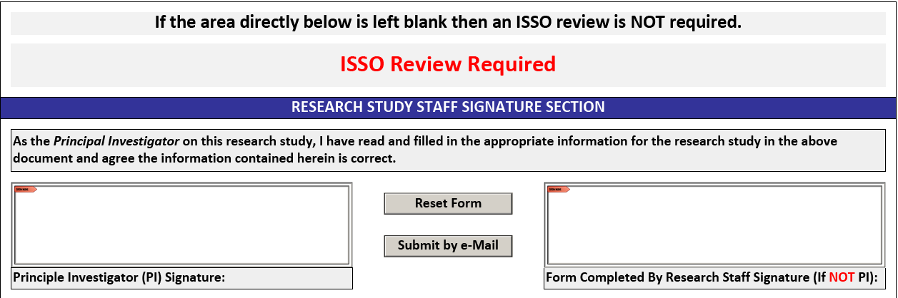
Research Study Staff Signature Section
The signature section displays a notice if an ISSO review is required.

Slide 30
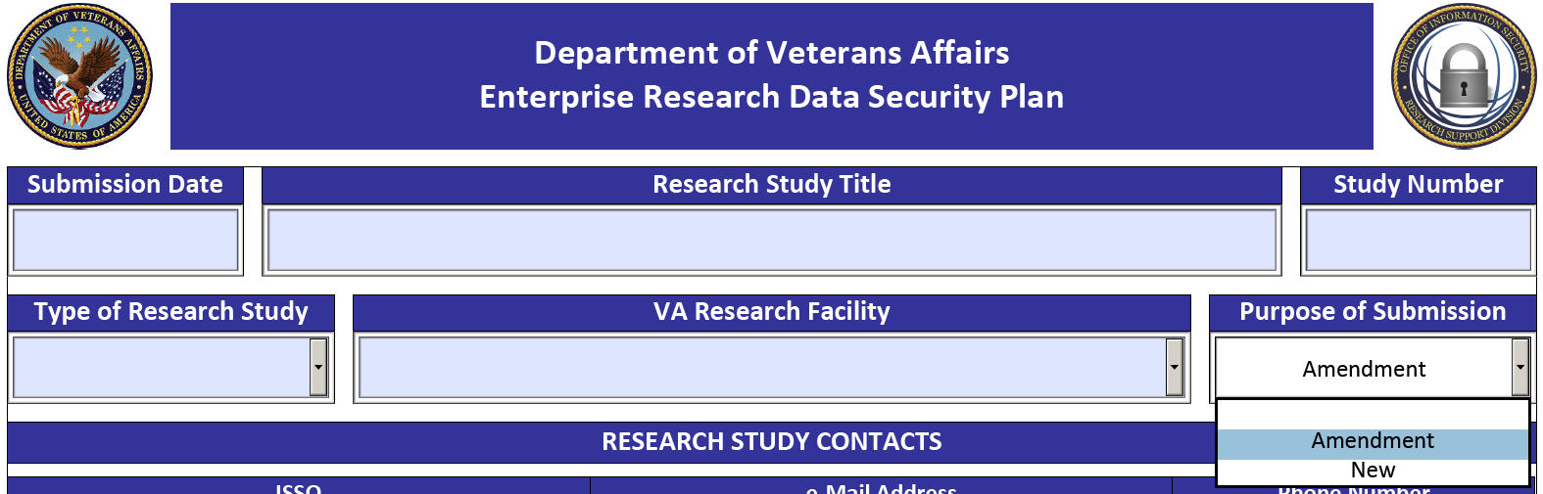
Amendment to Research Study (1 of 2)
The ERDSP is required for research study amendments. When initiating an ERDSP for a research study amendment, begin by completing the basic information about the research study at the top of the form.
Your response in the “Purpose of Submission” block activates the branching logic within the form and will determine the next question to be displayed.

Slide 31
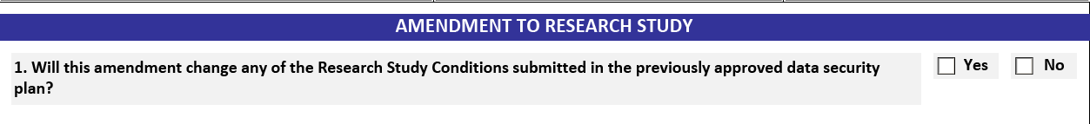
Amendment to Research Study (2 of 2)
The following question will be displayed after selecting “amendment” in the “purpose of submission” dropdown.

Slide 32
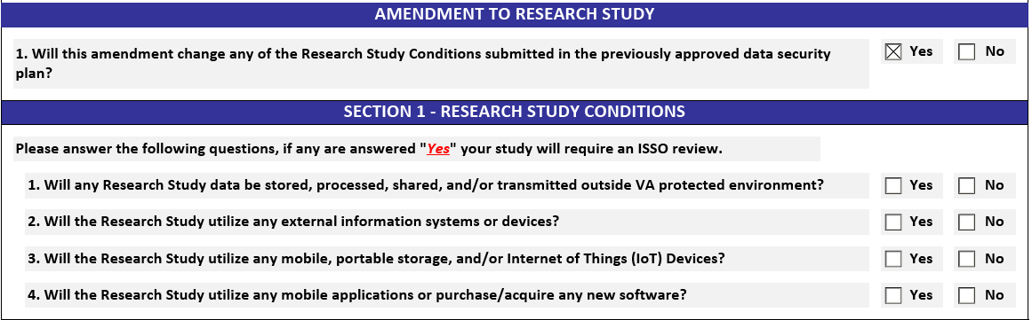
Amendment to Research Study (2 of 2)
If the question is answered “yes”, the template will display the Research Study Conditions. If any of the study conditions are marked “yes”, an ISSO review is required. The PI will need to complete the remaining questions on the ERDSP template and submit with their study submission.

Slide 33
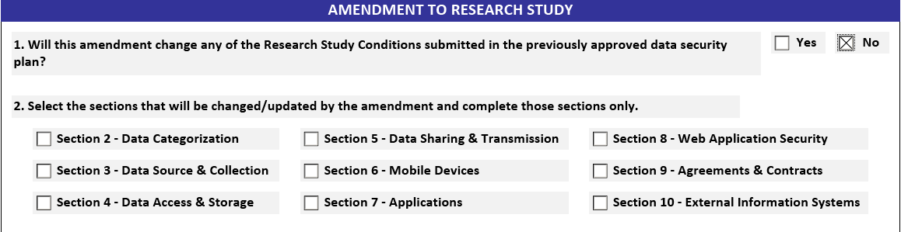
Amendment to Research Study (2 of 2)
If the question is answered “No”, an ISSO review is not required for the amendment.
The PI will select which sections of the ERDSP require updating from the previous ERDSP submission and complete those sections.
The completed ERDSP amendment is required to be submitted with the Research Study Amendment submission.

Slide 34
Conclusion
The ERDSP assists PIs with documenting how research data (human subject, basic science, animal) will be protected .
The ERDSP assists ISSOs with employing consistent security review checks.
The ERDSP removes the requirement for an ISSO review of Low Risk studies.

Slide 35
Contact Information
RSD Skype Session during the Soft Pilot Release.
Available March 23rd to April 17th, 8am to 4pm EDT.
Join Skype Meeting 844-825-8490 or 844-352-6288 ext. 886579162#
Research Support Division (RSD) on SharePoint
https://vaww.portal2.va.gov/sites/infosecurity/fieldsecurity/rs/default.aspx
RSD FAQs (General)
https://vaww.portal2.va.gov/sites/infosecurity/fieldsecurity/rs/Lists/RSD%20FAQ/AllItems.aspx
RSD FAQs for PIs
https://vaww.portal2.va.gov/sites/infosecurity/fieldsecurity/rs/Lists/RSD%20FAQ%20%20Principle%20Investigator%20PI/AllItems.aspx
RSD E-Mail Distribution List
OITITOPSSOESOResearchSupportDivision@va.gov

Slide 36
Questions?

